Slide 1

MGM Institute of Physiotherapy
Aurangabad
MAHATMA GANDHI MISSION
Didactic Lecture

Slide 2
SACROILIAC JOINT TESTS
Dr. surendra Wani
Dept. Of Musculoskeletal Physiotherapy
MGM Institute Of Physiotherapy
Chh. Sambhajinagar

Slide 3
Objectives
To understand and demonstrate the procedure for performing Sacroilliac joint special tests.

Slide 4
TEST FOR SACROILIAC JOINT
1) Approximation test ( compression provocation test)
2) Gapping test
* For neurological involvement-
1) Straight leg raise
* For sacroiliac joint involvement
1) Flamingo test
2) Gaenslen’s test
3) Gillet’s test

Slide 5
* For muscle dysfunction –
1) patrick test
2) Trendelenburg

Slide 6
1) APPROXIMATION TEST
Patient position- side lying
Procedure – examiner hand place over upper part of iliac crest, passing toward floor.
The movement cause forward pressure on the sacrum.
Positive test- Increase feeling of pressure in the SI Joint
Indicate sacroiliac lesion/ sprain of post sacroiliac ligament

Slide 7
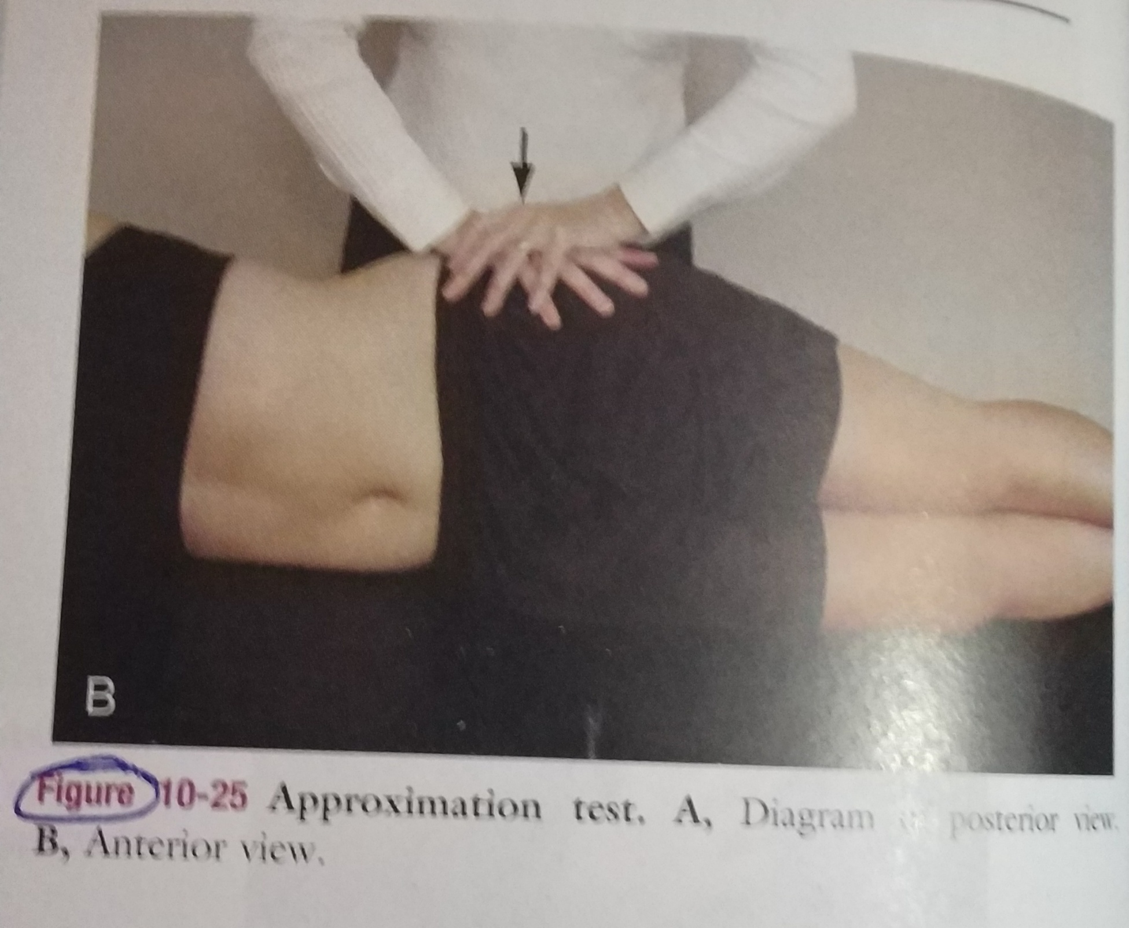

Slide 8
2)GAPPING TEST
Patient position- supine lying
Procedure – Examiner applies crossed-arm pressure to the ASIS.
The examiner pushes down and out with arm.
Positive test – unilateral gluteal or post leg pain is produced
Indicating sprain of anterior sacroiliac ligament

Slide 9
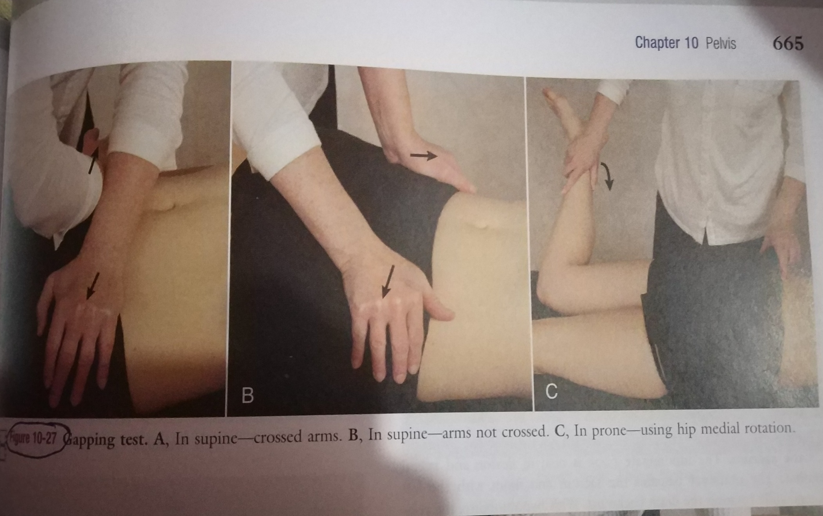

Slide 10
B) For neurological involvement
1) STRAIGHT LEG RAISE TEST( LESEGUE’S TEST)
Patient position – supine lying
Procedure –Examiner passively flexes the patient hip with knee extended
Positive test- pain occurring after 70 degree is usually indicative sacroiliac joint pain.
Passive bilateral straight leg raising test-

Slide 11
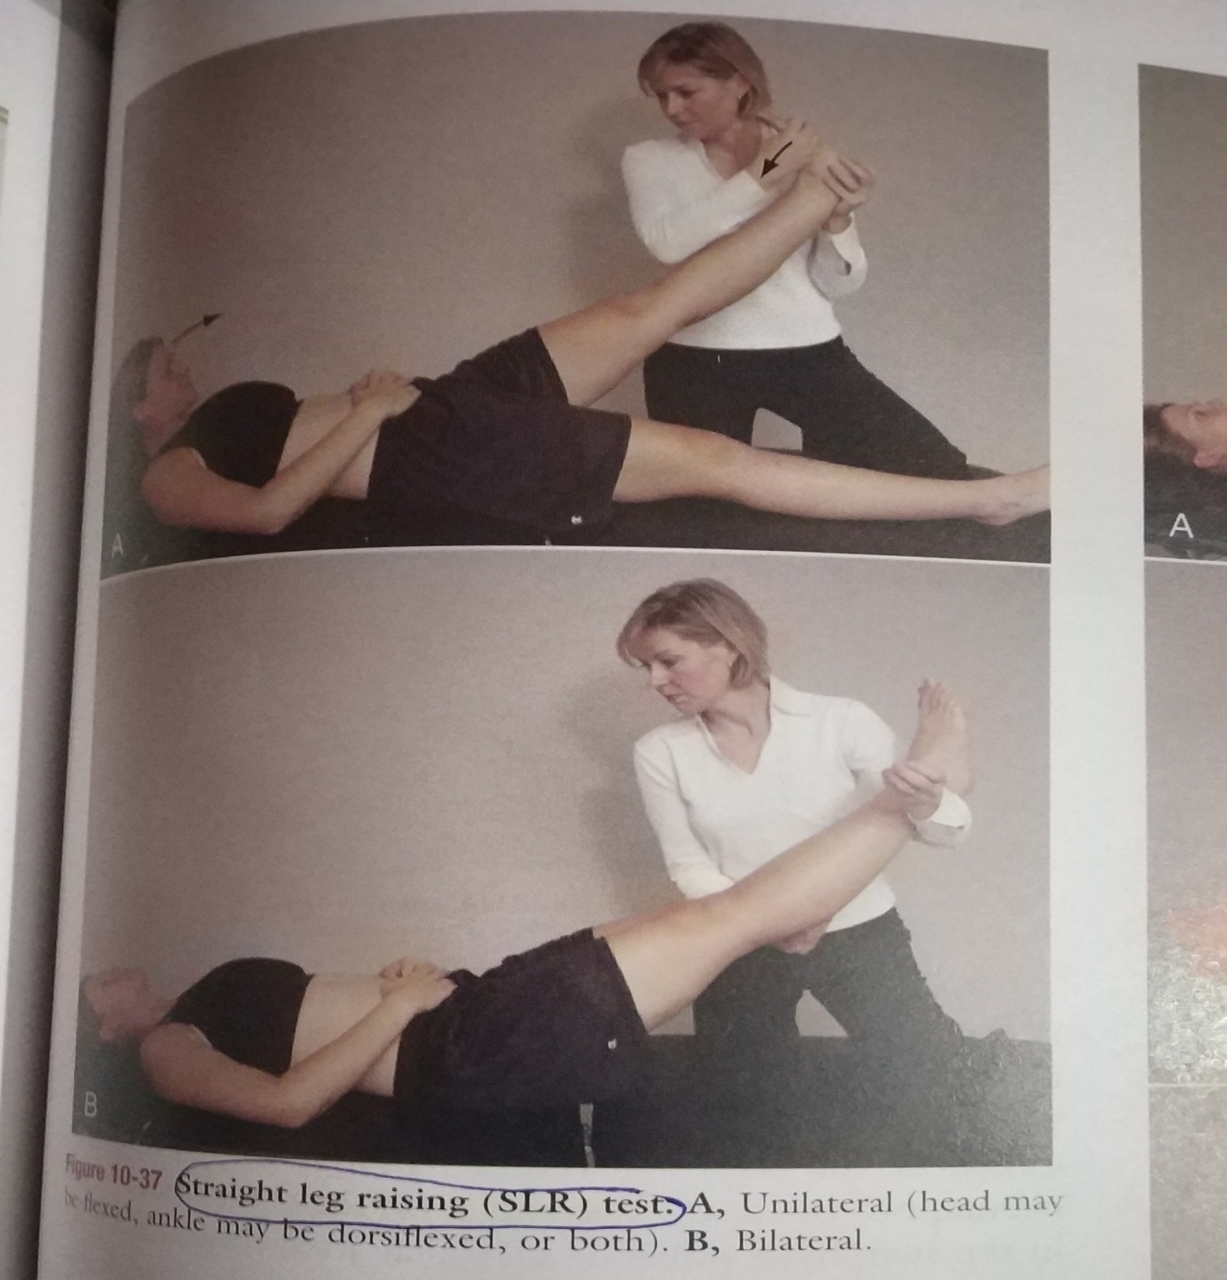

Slide 12
c) For sacroiliac joint involvement
1) FLAMINGO TEST-
Patient position- standing.
Procedure – patient is asked to stand on one leg.
Positive test- pain in symphysis pubis or sacroiliac joint

Slide 13
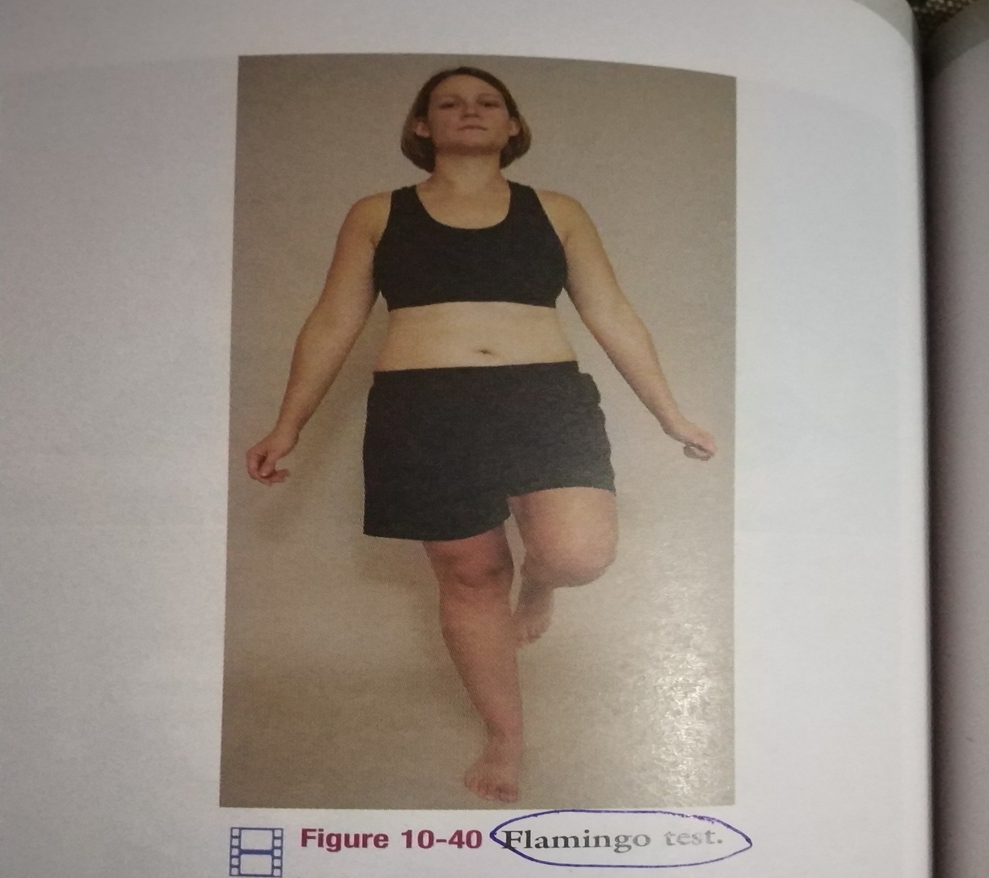

Slide 14
2) GAENSLEN’S TEST-
Patient position- patient lie on the side with upper leg hyperextended at hip.
Procedure- patient hold the lower leg flexed against the chest. Examiner stabilize the pelvic while extending the hip of uppermost leg
Pain indicate positive test.

Slide 15
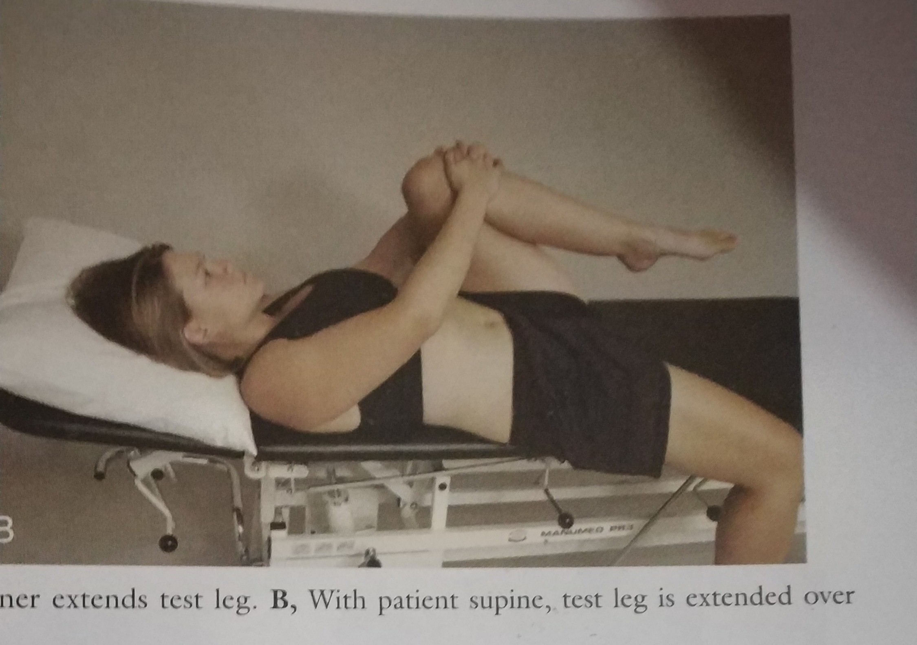

Slide 16
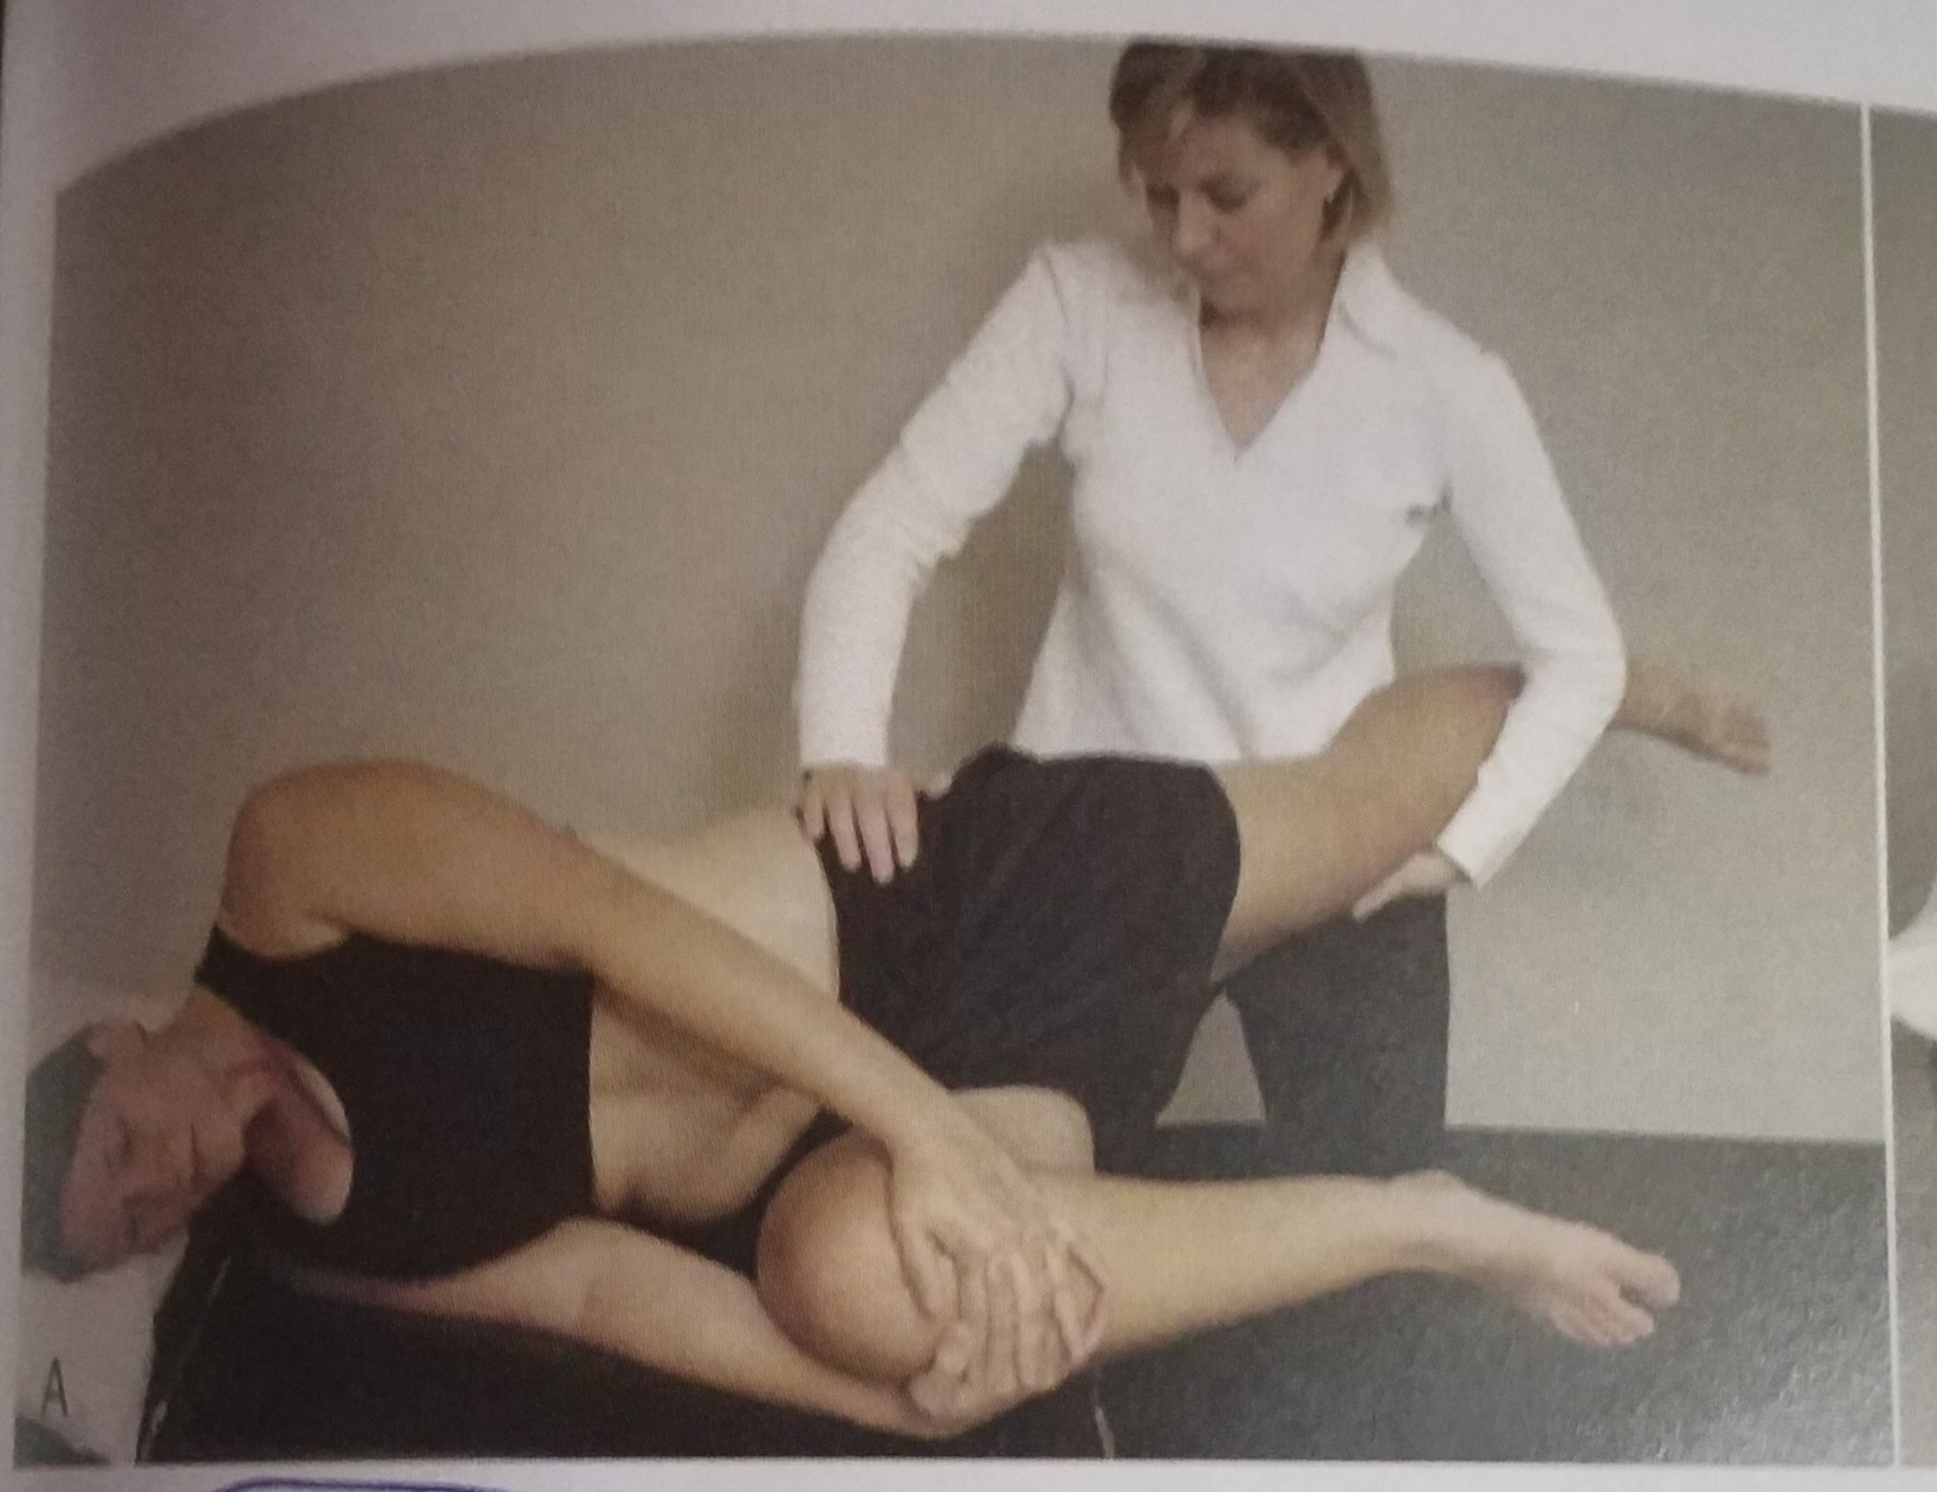

Slide 17
3) GILLET’S TEST-
Ipsilateral posterior rotation test
Patient position- standing.
Procedure- the sitting examiner palpate the PSIS with one thumb and other thumb parallel with the other thumb on the sacrum.
Patient is then asked to stand on one leg while pulling the opposite knee up toward the chest

Slide 18
Positive test- If the SI joint on the side on which the knee flexed move minimally or up, the joint is said to be hypomobile, or ‘blocked’.

Slide 19
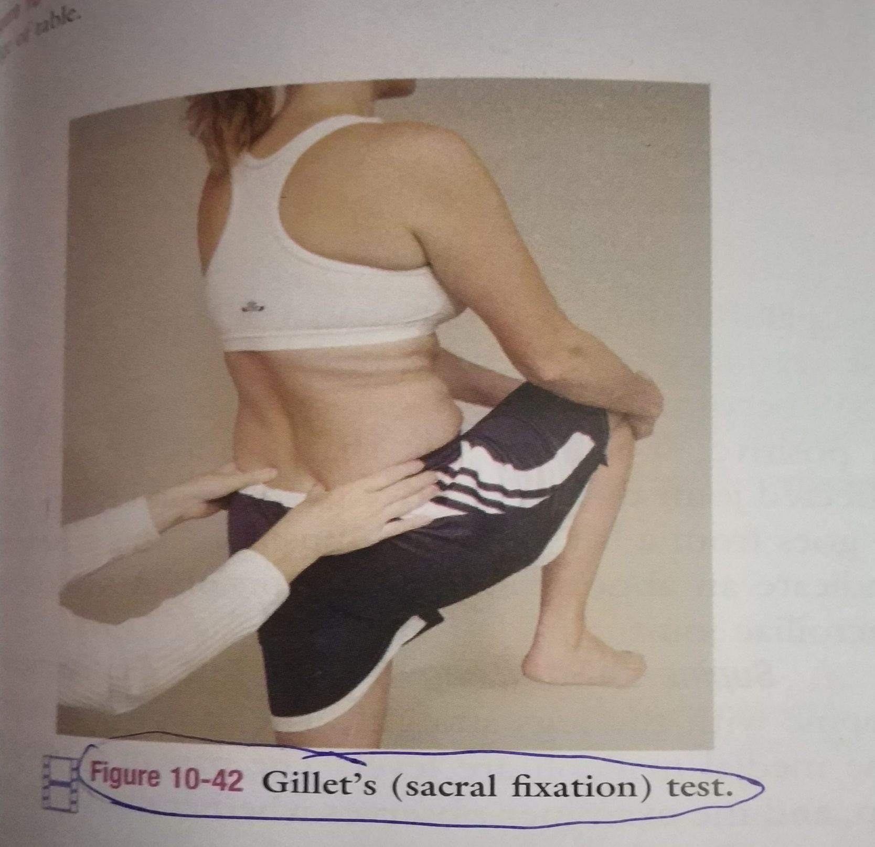

Slide 20
D) For muscle dysfunction
1) PATRICK TEST-
Patient position – supine lying
Positive test- the test leg knee remaining above the opposite straight leg

Slide 21
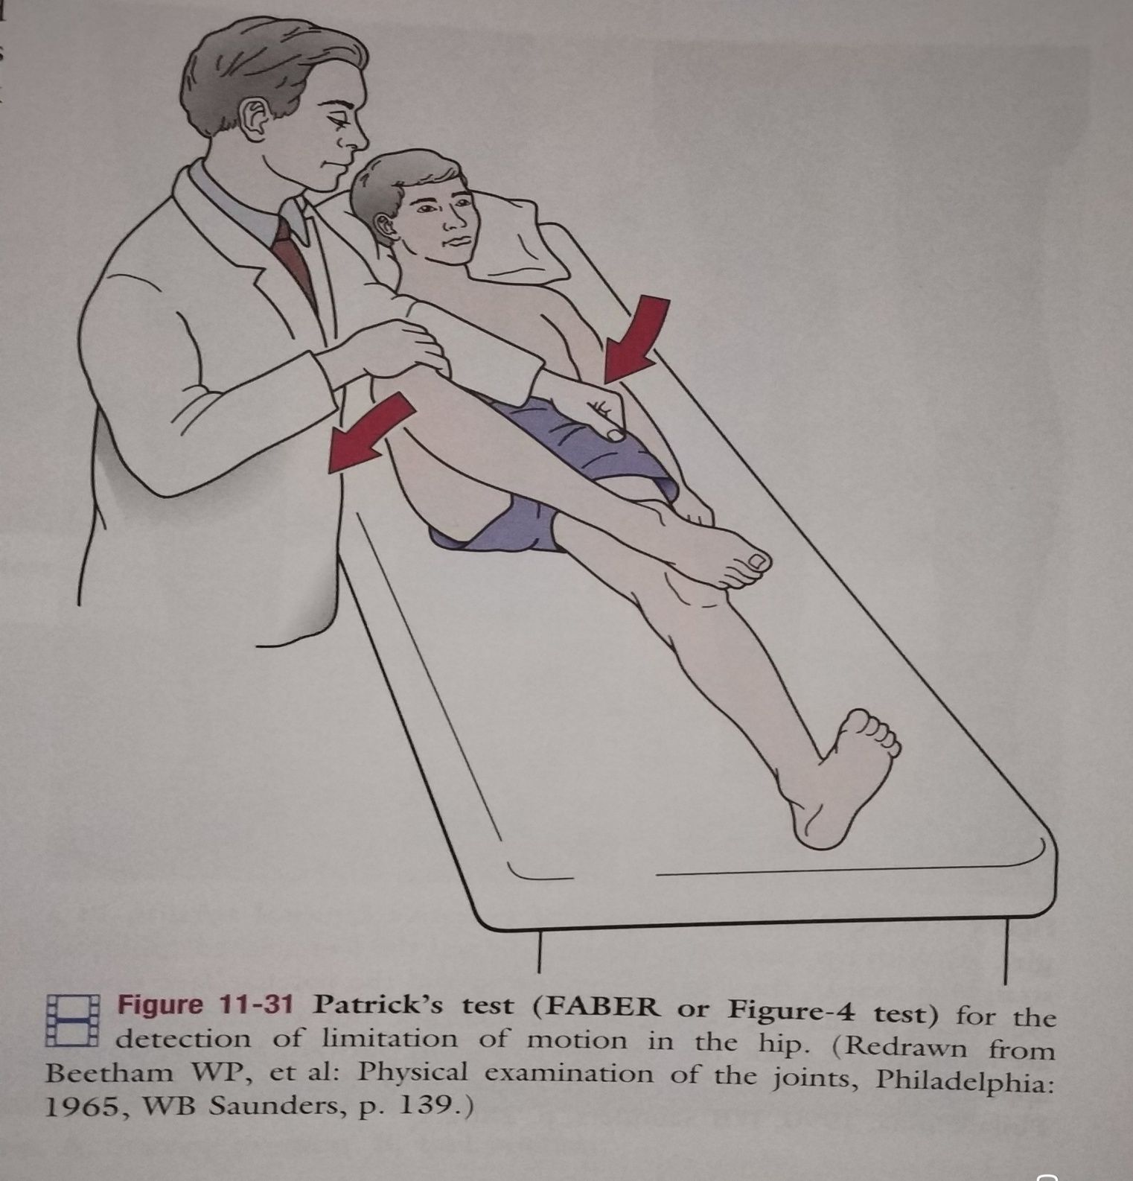

Slide 22
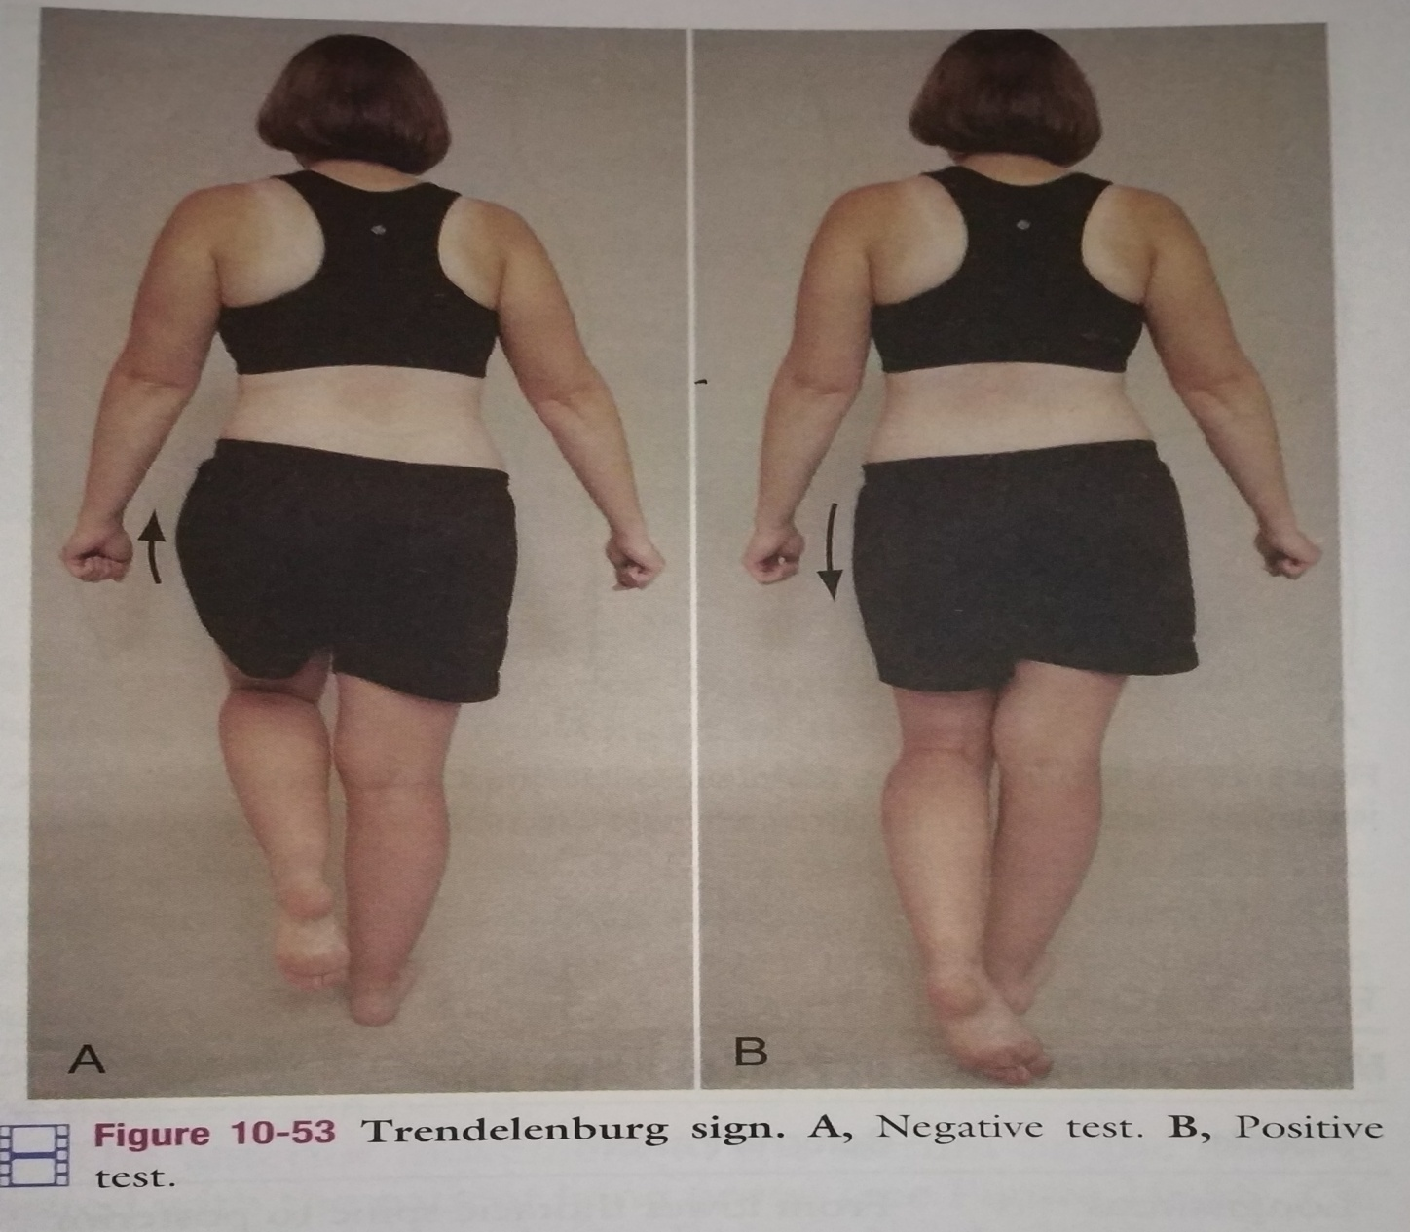
2) Trendelenburg sign

Slide 23
Summary & Questions
Faber’s Patricks test

